Slide 1


Alexander
Dec 2021

Slide 2

Outline
Executive Summary
Introduction
Methodology
Results
Conclusion
Appendix

Slide 3
Executive Summary
Summary of methodologies
Summary of all results

Slide 4
Introduction
Project background and context
Problems you want to find answers

Slide 5


Slide 6
Methodology
Executive Summary
Data collection methodology:
Describe how data was collected
Perform data wrangling
Describe how data was processed
Perform exploratory data analysis (EDA) using visualization and SQL
Perform interactive visual analytics using Folium and Plotly Dash
Perform predictive analysis using classification models
How to build, tune, evaluate classification models

Slide 7
Data Collection
Describe how data sets were collected.
You need to present your data collection process use key phrases and flowcharts

Slide 8
Data Collection – SpaceX API
Present your data collection with SpaceX REST calls using key phrases and flowcharts
Add the GitHub URL of the completed SpaceX API calls notebook (must include completed code cell and outcome cell), as an external reference and peer-review purpose
Place your flowchart of SpaceX API calls here

Slide 9
Data Collection - Scraping
Present your web scraping process using key phrases and flowcharts
Add the GitHub URL of the completed web scraping notebook, as an external reference and peer-review purpose
Place your flowchart of web scraping here

Slide 10
Data Wrangling
Describe how data were processed
You need to present your data wrangling process using key phrases and flowcharts
Add the GitHub URL of your completed data wrangling related notebooks, as an external reference and peer-review purpose

Slide 11
EDA with Data Visualization
Summarize what charts were plotted and why you used those charts
Add the GitHub URL of your completed EDA with data visualization notebook, as an external reference and peer-review purpose
https://github.com/a-schier/IBM-DS-Capstone/blob/1c54e12fb3b32e8b5cdb2d536ba8c8482891e55c/jupyter-labs-eda-dataviz.ipynb

Slide 12
EDA with SQL
Using bullet point format, summarize the SQL queries you performed
Add the GitHub URL of your completed EDA with SQL notebook, as an external reference and peer-review purpose

Slide 13
Build an Interactive Map with Folium
Summarize what map objects such as markers, circles, lines, etc. you created and added to a folium map
Explain why you added those objects
Add the GitHub URL of your completed interactive map with Folium map, as an external reference and peer-review purpose

Slide 14
Build a Dashboard with Plotly Dash
Summarize what plots/graphs and interactions you have added to a dashboard
Explain why you added those plots and interactions
Add the GitHub URL of your completed Plotly Dash lab, as an external reference and peer-review purpose

Slide 15
Predictive Analysis (Classification)
Summarize how you built, evaluated, improved, and found the best performing classification model
You need present your model development process using key phrases and flowchart
Add the GitHub URL of your completed predictive analysis lab, as an external reference and peer-review purpose

Slide 16
Results
Exploratory data analysis results
The success rate for number of successful landings have increased markedly in recent years
Interactive analytics demo in screenshots
Predictive analysis results

Slide 17


Slide 18
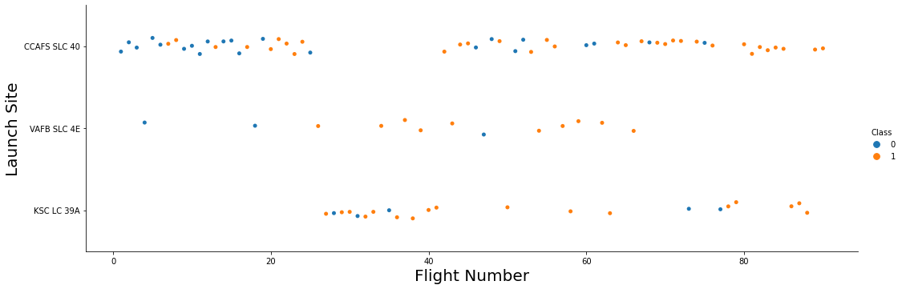
Flight Number vs. Launch Site
The above graph shows three takeaways:
The success rate increases with flight number overall
The success rate is the higher for KSC LC 39A and VAFB SLC 4E than CCAFS SLC 40
Most launches happen from CCAFS SLC 40 with a break in the middle

Slide 19
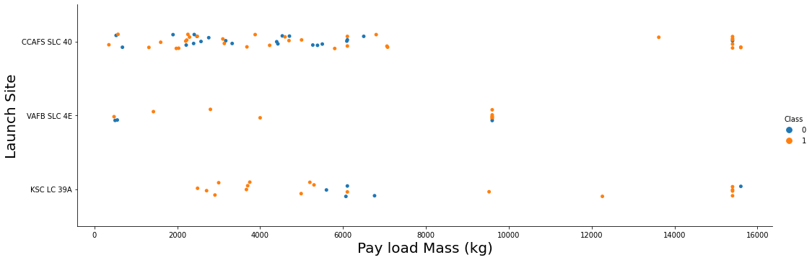
Payload vs. Launch Site
The payload varies for each flight and the maximum payload is different for each launch site (VAFB SLC 4E w/ ~950 kg vs CCAFS SLC 40 and KSC LC 39A w/ ~1550 kg)

Slide 20
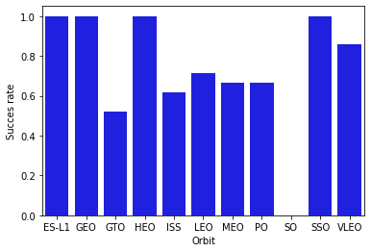
Success Rate vs. Orbit Type
Some orbit types have higher success rates than others:
ES-L1, GEO, HEO and SSO all have a 100% success rate

Slide 21
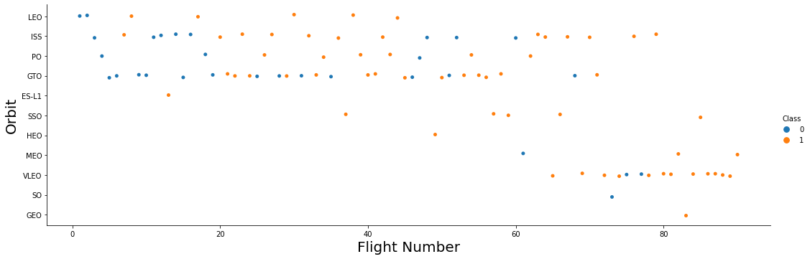
Flight Number vs. Orbit Type
Over time the type of mission has be changed from LEO/ISS/PO/GTO orbits to HEO/MEO/VLEO orbits
There is a positive correlation between success rate of the LEO orbit and flight number, but no such relationship exists for GTO – i.e. LEO launches get better over time but GTO launches do not

Slide 22
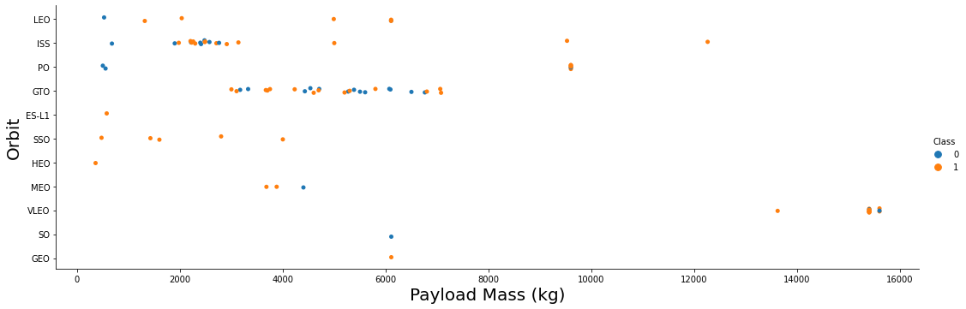
Payload vs. Orbit Type
With heavy payloads the successful landing rates are more for Polar, LEO and ISS.
However for GTO we cannot distinguish this as both succesful- and unsuccessful missions are both there here.

Slide 23
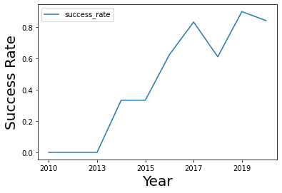
Launch Success Yearly Trend
It is seen that there exists an overall trend that the success rate of the launches increase year by year

Slide 24
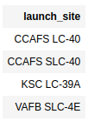
All Launch Site Names
Find the names of the unique launch sites
The SQL query to find these are:
SELECT DISTINCT(LAUNCH_SITE) FROM SPACEXTBL;
See output of the query on the right

Slide 25
Launch Site Names Begin with 'CCA'
Find 5 records where launch sites begin with `CCA`
The SQL query to find these are:
SELECT * FROM SPACEXTBL WHERE LAUNCH_SITE LIKE 'CCA%' LIMIT 5;
See output of the query on the next slide

Slide 26
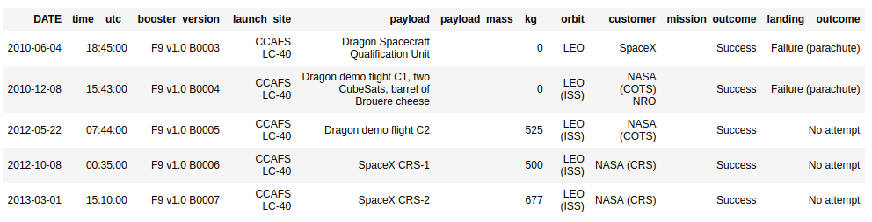
Launch Site Names Begin with 'CCA'

Slide 27
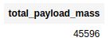
Total Payload Mass
Calculate the total payload carried by boosters from NASA
The SQL query to find these are:
SELECT SUM(PAYLOAD_MASS__KG_) AS TOTAL_PAYLOAD_MASS FROM SPACEXTBL WHERE CUSTOMER = 'NASA (CRS)';
See output of the query on the right

Slide 28
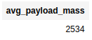
Average Payload Mass by F9 v1.1
Calculate the average payload mass carried by booster version F9 v1.1
The SQL query to find these are:
SELECT AVG(PAYLOAD_MASS__KG_) AS AVG_PAYLOAD_MASS FROM SPACEXTBL WHERE BOOSTER_VERSION LIKE '%F9 v1.1%';
See output of the query on the right

Slide 29
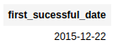
First Successful Ground Landing Date
Find the dates of the first successful landing outcome on ground pad
The SQL query to find these are:
SELECT MIN(DATE) as FIRST_SUCESSFUL_DATE FROM SPACEXTBL WHERE LANDING__OUTCOME = 'Success (ground pad)';
See output of the query on the right

Slide 30
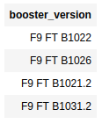
Successful Drone Ship Landing with Payload between 4000 and 6000
List the names of boosters which have successfully landed on drone ship and had payload mass greater than 4000 but less than 6000
The SQL query to find these are:
SELECT BOOSTER_VERSION FROM SPACEXTBL WHERE LANDING__OUTCOME = 'Success (drone ship)' AND PAYLOAD_MASS__KG_ BETWEEN 4000 AND 6000;
See output of the query on the right

Slide 31
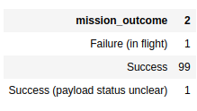
Total Number of Successful and Failure Mission Outcomes
Calculate the total number of successful and failure mission outcomes
The SQL query to find these are:
SELECT MISSION_OUTCOME, COUNT(*) FROM SPACEXTBL GROUP BY MISSION_OUTCOME;
See output of the query on the right

Slide 32
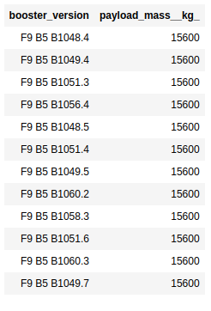
Boosters Carried Maximum Payload
List the names of the booster which have carried the maximum payload mass
The SQL query to find these are:
SELECT BOOSTER_VERSION, PAYLOAD_MASS__KG_ FROM SPACEXTBL WHERE PAYLOAD_MASS__KG_ = (SELECT MAX(PAYLOAD_MASS__KG_) FROM SPACEXTBL);
See output of the query on the right

Slide 33
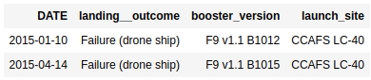
2015 Launch Records
List the failed landing_outcomes in drone ship, their booster versions, and launch site names for in year 2015
The SQL query to find these are:
SELECT DATE, LANDING__OUTCOME, BOOSTER_VERSION, LAUNCH_SITE FROM SPACEXTBL WHERE LANDING__OUTCOME = 'Failure (drone ship)' AND YEAR(DATE) = 2015;
See output of the query on the right

Slide 34
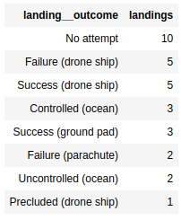
Rank Landing Outcomes Between 2010-06-04 and 2017-03-20
Rank the count of landing outcomes (such as Failure (drone ship) or Success (ground pad)) between the date 2010-06-04 and 2017-03-20, in descending order
The SQL query to find these are:
SELECT LANDING__OUTCOME, COUNT(*) AS LANDINGS FROM SPACEXTBL WHERE DATE BETWEEN '2010-06-04' AND '2017-03-20' GROUP BY LANDING__OUTCOME ORDER BY LANDINGS DESC;
See output of the query on the right

Slide 35


Slide 36
Launch Site Locations
Replace <Folium map screenshot 1> title with an appropriate title
Explore the generated folium map and make a proper screenshot to include all launch sites’ location markers on a global map
Explain the important elements and findings on the screenshot

Slide 37
<Folium Map Screenshot 2>
Replace <Folium map screenshot 2> title with an appropriate title
Explore the folium map and make a proper screenshot to show the color-labeled launch outcomes on the map
Explain the important elements and findings on the screenshot

Slide 38
<Folium Map Screenshot 3>
Replace <Folium map screenshot 3> title with an appropriate title
Explore the generated folium map and show the screenshot of a selected launch site to its proximities such as railway, highway, coastline, with distance calculated and displayed
Explain the important elements and findings on the screenshot

Slide 39


Slide 40
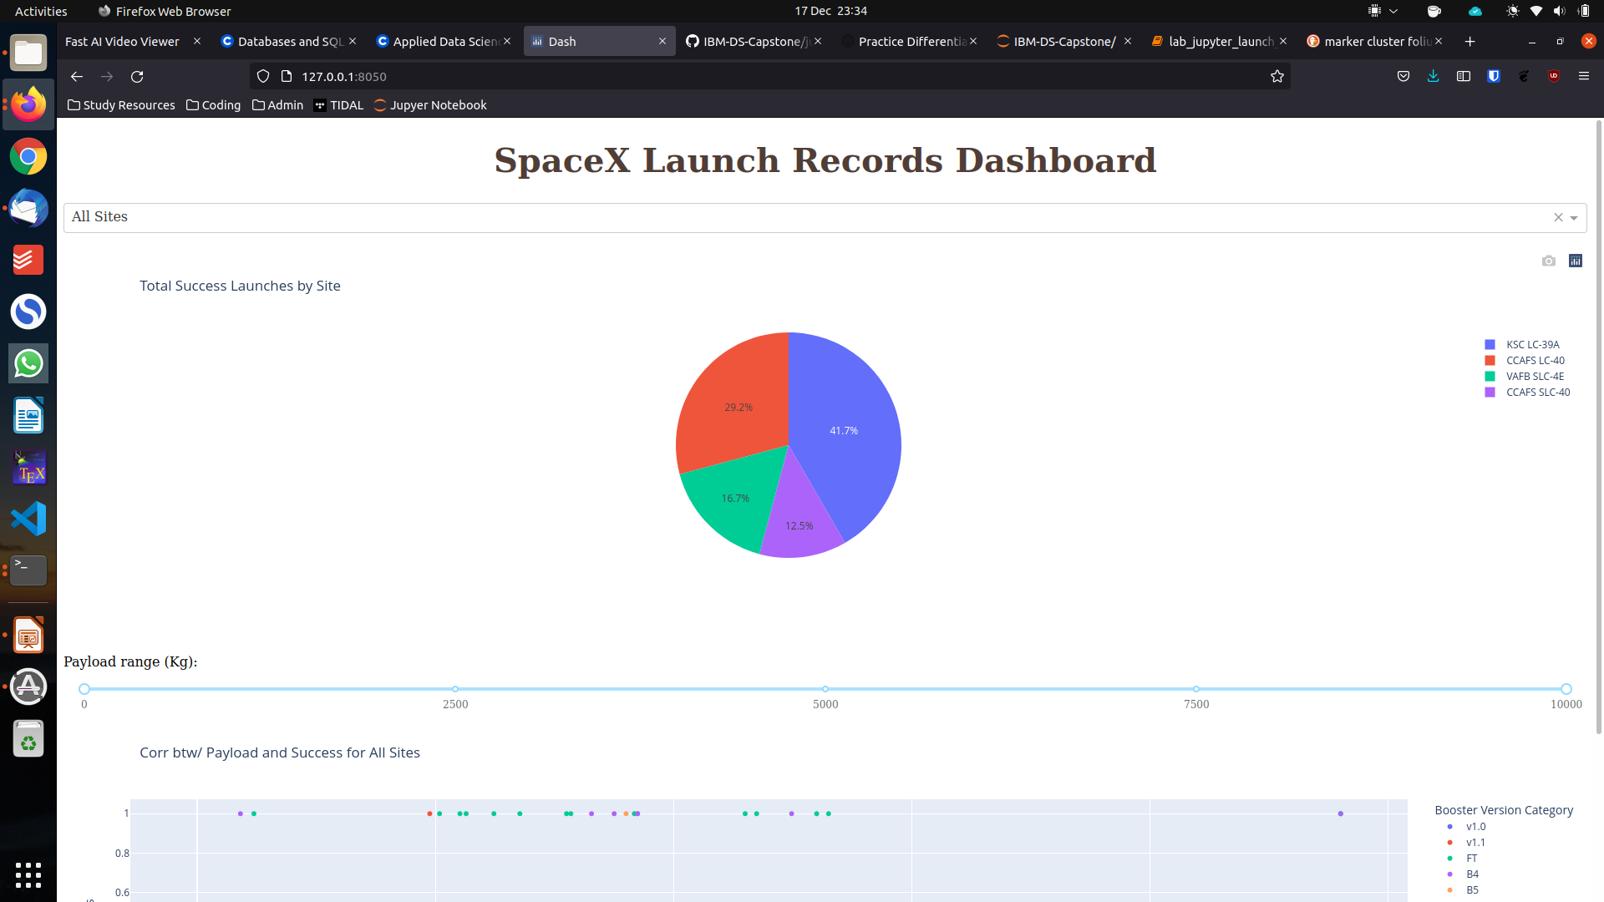
Launch success for all sites

Slide 41
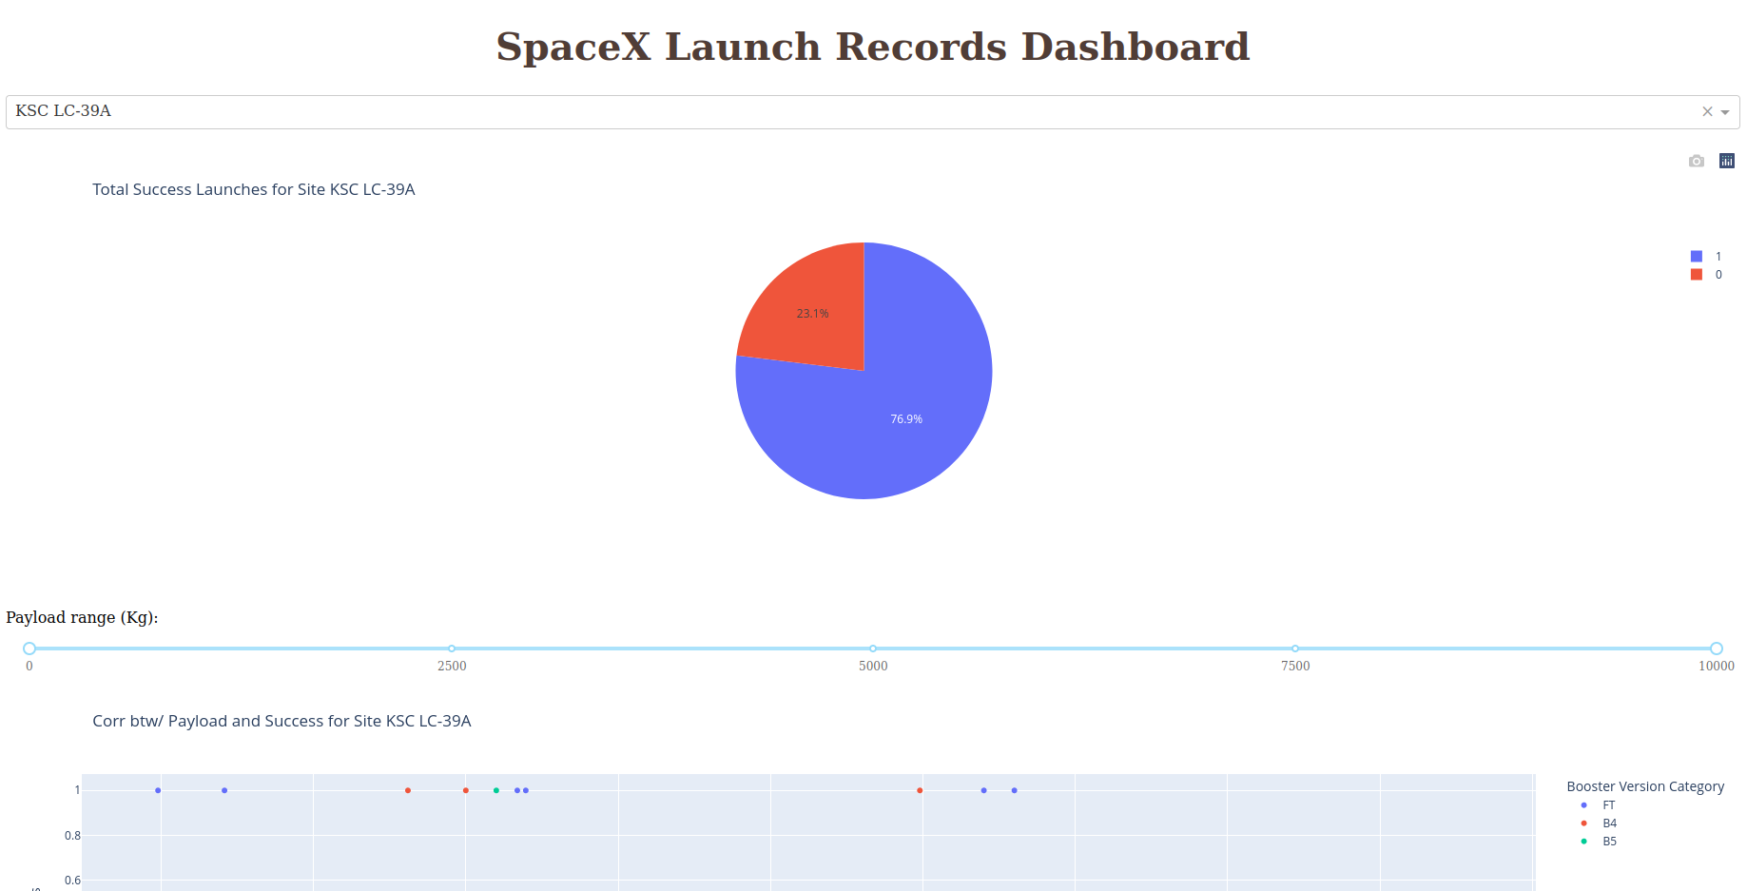
Launch Site with Highest Success Ratio

Slide 42
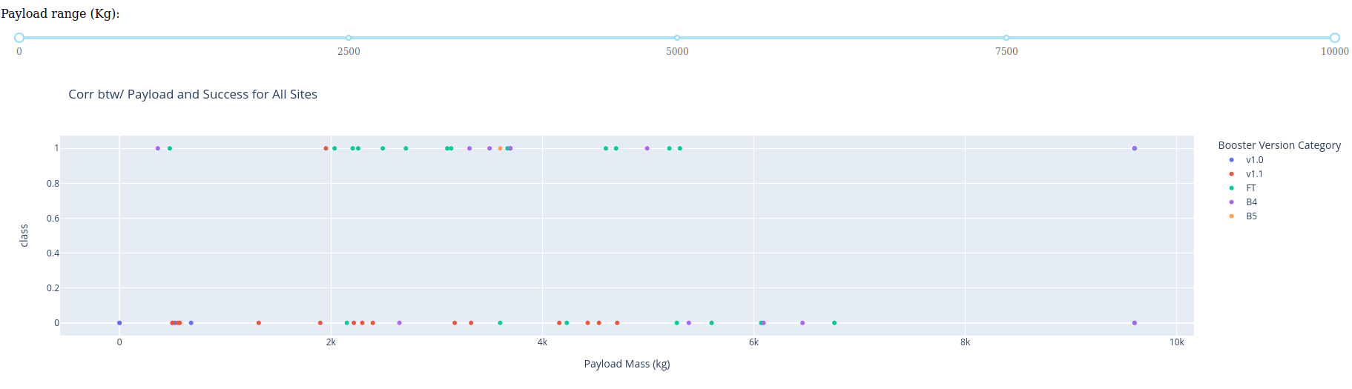
Payload vs Launch Outcome for All Sites

Slide 43


Slide 44
Classification Accuracy
Visualize the built model accuracy for all built classification models, in a bar chart
Find which model has the highest classification accuracy

Slide 45
Confusion Matrix
Show the confusion matrix of the best performing model with an explanation

Slide 46
Conclusions
Point 1
Point 2
Point 3
Point 4
…

Slide 47
Appendix
Include any relevant assets like Python code snippets, SQL queries, charts, Notebook outputs, or data sets that you may have created during this project

Slide 48


